Slide 1
MESC Rivet Optimization
06/12/2019
Liam Brown
Structures and Composites Laboratory (SACL)
Department of Aeronautics and Astronautics
Stanford University
Email: Lpbrown@stanford.edu
Website: http://structure.stanford.edu
1

Slide 2
Introduction
Tradeoff between battery stiffness, energy density in MESC cell design
We know adding rivets / increasing rivet diameter will increase mechanical stiffness
How do we add them most efficiently (least reduction in energy capacity to achieve a desired stiffness)?
Extension of Anthony Bombiks work
This investigated only grid based rivet schemes with a constant polymer volume rather than using arbitrary layout, optimization and varying polymer volume
Goal: Use optimization techniques to determine optimal layout design for an MESC cell
Methodology: Perform zero-order optimization in Python using a dynamic FEM (Abaqus) to act as function evaluations

Slide 3
Problem Statement
Optimize a single MESC cell by determining the optimal configuration of internal polymer rivets to exhibit a certain stiffness while maximizing its electrical capacity
To do this, we solve a constrained optimization problem
Design constants are cell dimensions, face sheets, frame width
Design variables are number of rivets, their location, and their size
Design constraints include rivet clearance and minimum stiffness
Design objective is to maximize the energy capacity

Slide 4
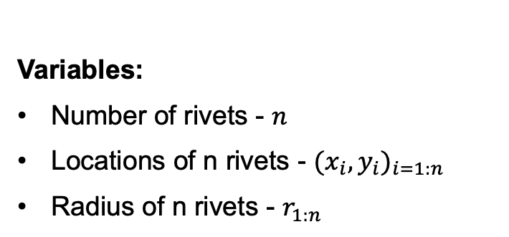
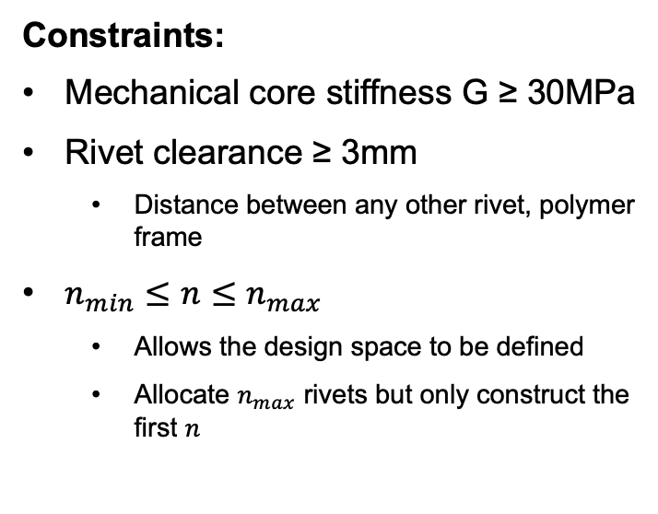
Optimization Problem
Objective: Maximize Energy Density
(Maximize battery volume)
Constraints:
Mechanical core stiffness G ≥ 30MPa
Rivet clearance ≥ 3mm
Distance between any other rivet, polymer frame
$n_{min}≤n≤n_{max}$
Allows the design space to be defined
Allocate $n_{max}$ rivets but only construct the first $n$
Variables:
Number of rivets - $n$
Locations of n rivets - ${{(x}_{i},y_{i})}_{i=1:n}$
Radius of n rivets - $r_{1:n}$
Design Constants:
Cell dimensions (110mm x 110mm)
Frame width (10mm)
Face sheet design ([0/90/90/0])
Core thickness (5mm)
Potential Constraints, Objectives (not currently included):
Maximum strain, stress on the battery / polymer / face sheet
Thermal considerations

Slide 5
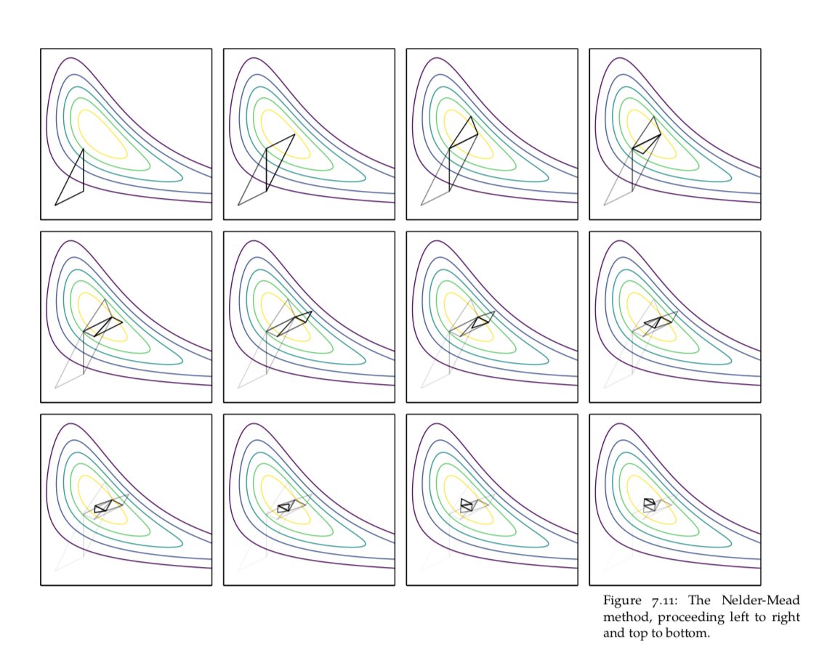
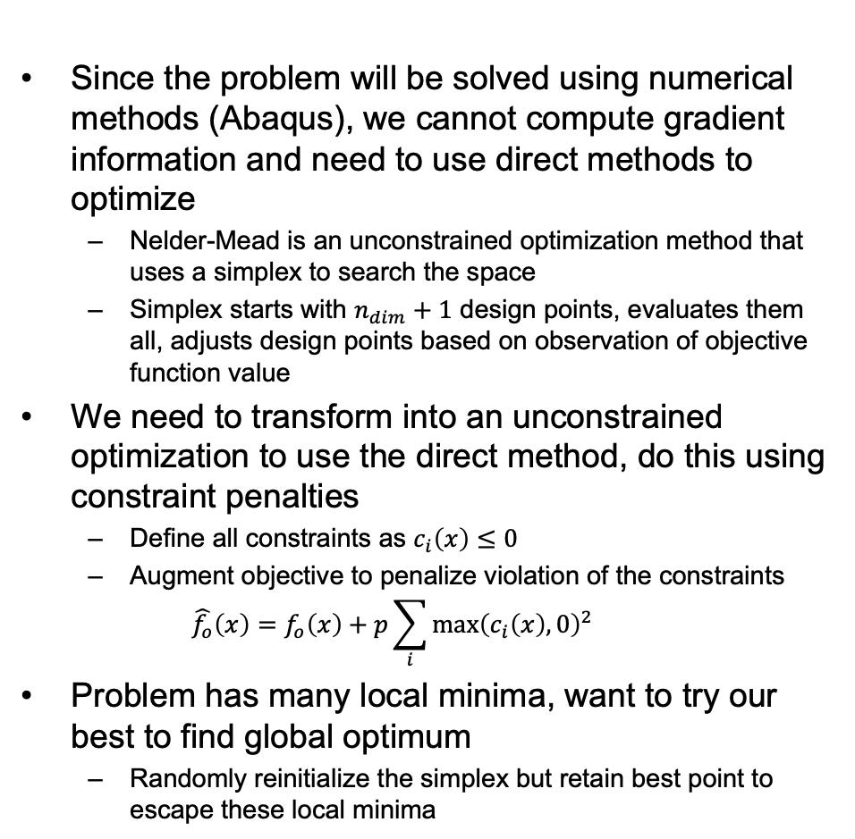
Optimization Methodology
Since the problem will be solved using numerical methods (Abaqus), we cannot compute gradient information and need to use direct methods to optimize
Nelder-Mead is an unconstrained optimization method that uses a simplex to search the space
Simplex starts with $n_{dim}+1$ design points, evaluates them all, adjusts design points based on observation of objective function value
We need to transform into an unconstrained optimization to use the direct method, do this using constraint penalties
Define all constraints as $c_{i}\left(x\right)≤0$
Augment objective to penalize violation of the constraints
$$\hat{f_{o}}\left(x\right)=f_{o}\left(x\right)+p\sum_{i}{{\max\left(c_{i}\left(x\right),0\right)}^{2}}$$
Problem has many local minima, want to try our best to find global optimum
Randomly reinitialize the simplex but retain best point to escape these local minima
Nelder – Mead Simplex direct optimization method visualized on a two dimensional problem.
Kochenderfer, M. J., and Wheeler, T. A.,
Algorithms for Optimization, The MIT Press, 2019

Slide 6
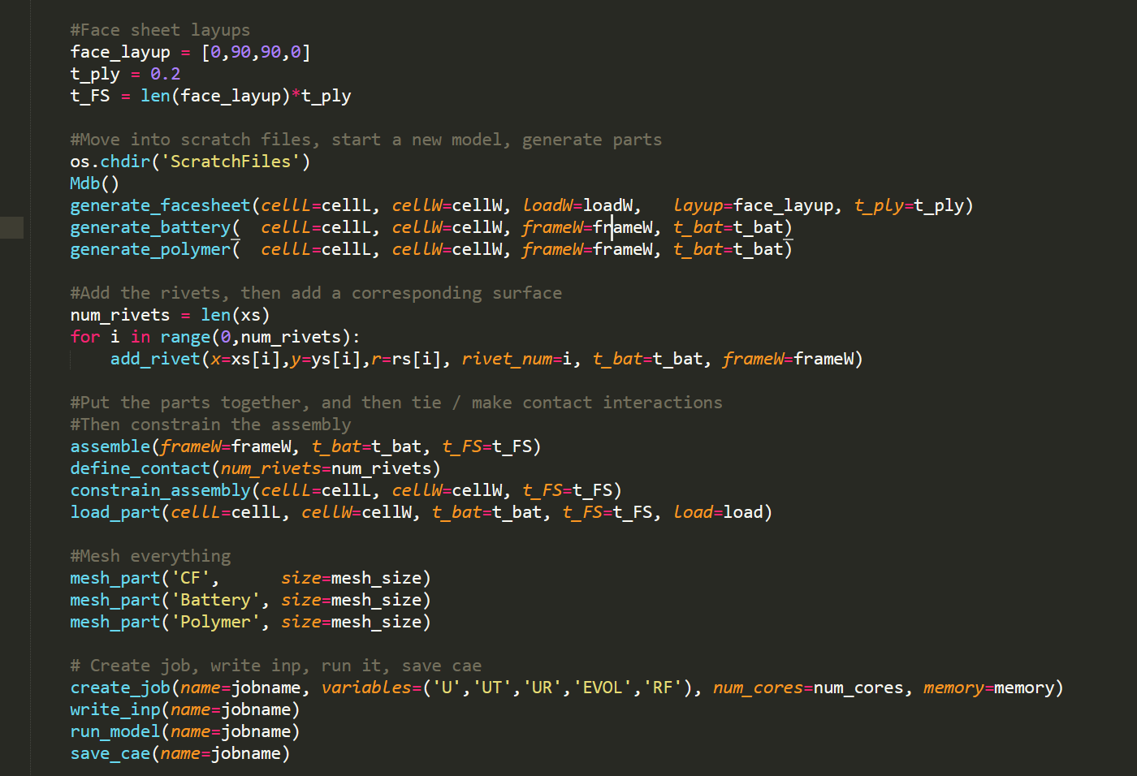

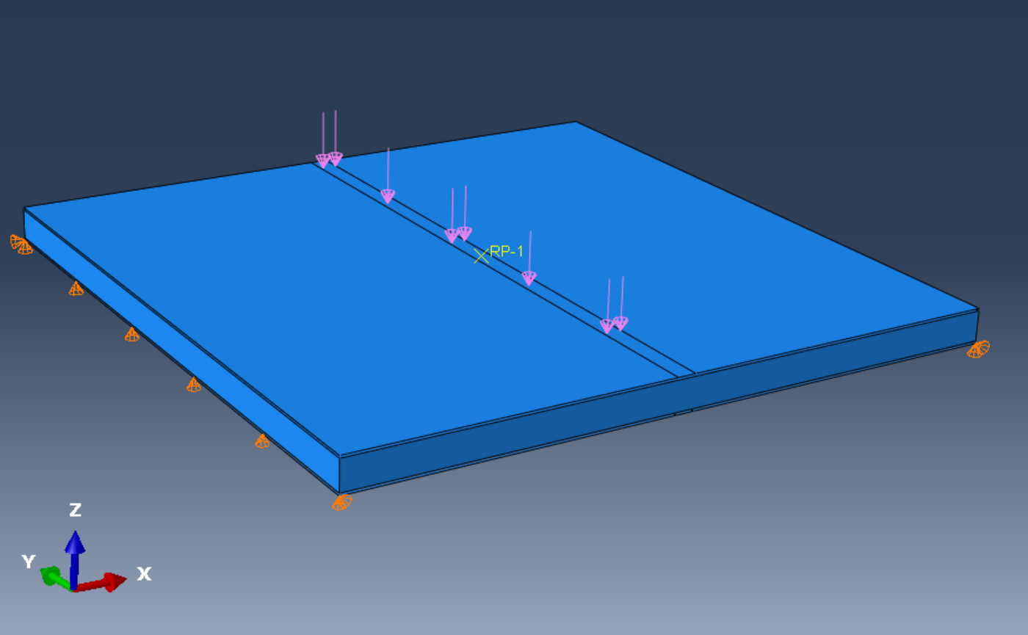

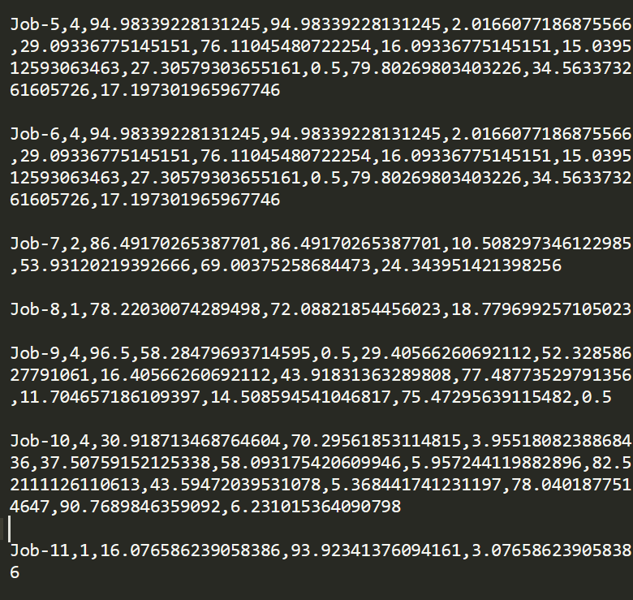
Optimization Procedure
0. Determine initial design simplex, objective function, constraints
Select design point to be analyzed
Call Abaqus with python script
3. Run simulation on design
4. Extract results
5. Evaluate and record design
(Compute G, battery volume)
6. Adjust simplex based on evaluation
7. Randomly reinitialize all but the best points in the simplex

Slide 7
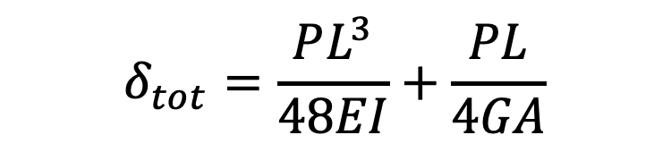
Cell Analysis Methodology
Extract relevant values from the model once it has run (battery volume, deflection)
From the deflection, we can back calculate the homogenized shear stiffness of the core
Currently using simple sandwich theory, can improve prediction by switching to advanced sandwich theory
$$δ_{tot}=\frac{PL^{3}}{48EI}+\frac{PL}{4GA}$$
Deflection from simulation
Predicted bending stiffness of entire cross section
Homogenized shear modulus of core

Slide 8
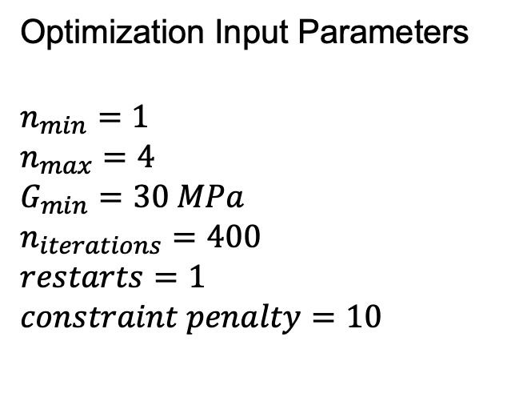
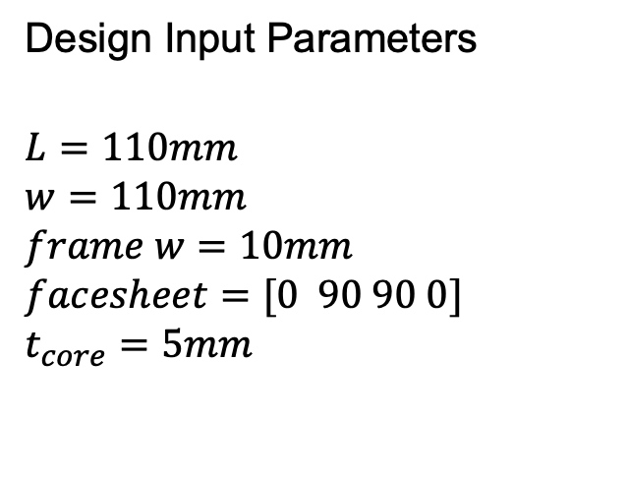
Preliminary Results
Design Input Parameters
$$L=110mm$$
$$w=110mm$$
$$frame w=10mm$$
$$facesheet=[0 90 90 0]$$
$$t_{core}=5mm$$
Optimization Input Parameters
$$n_{min}=1$$
$$n_{max}=4$$
$$G_{min}=30 MPa$$
$$n_{iterations}=400$$
$$restarts=1$$
$$constraint penalty=10$$
These input parameters were used to prove the functionality of the method
They do not represent a cell that should necessarily be constructed or has a use case
To come up with an optimized cell for manufacturing, we need to carefully define the requirements of the system before optimization

Slide 9
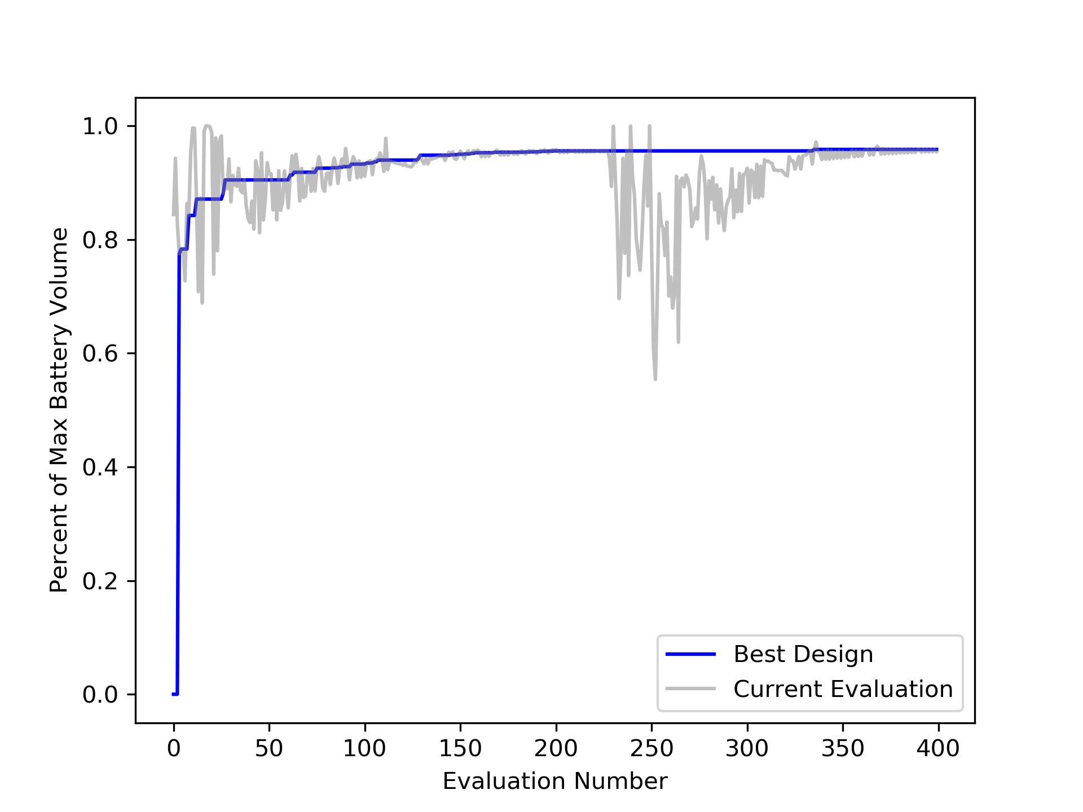
Preliminary Results - Optimization

Slide 10
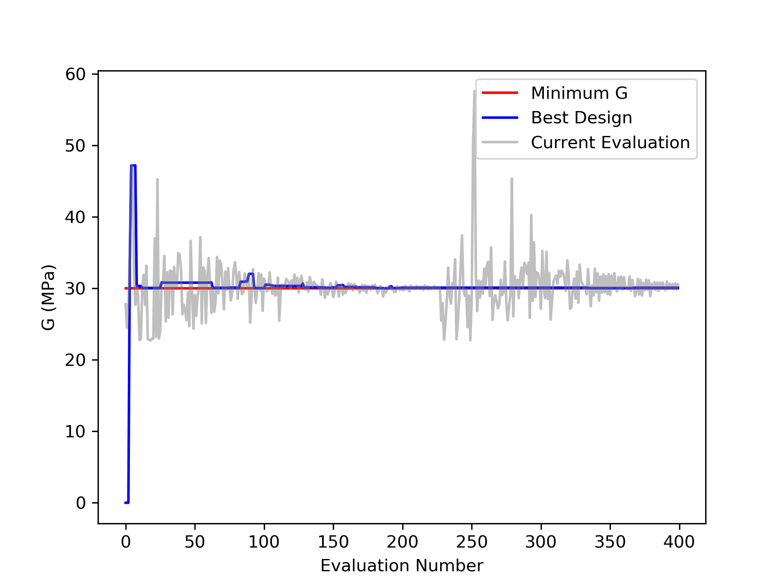
Preliminary Results - Optimization

Slide 11
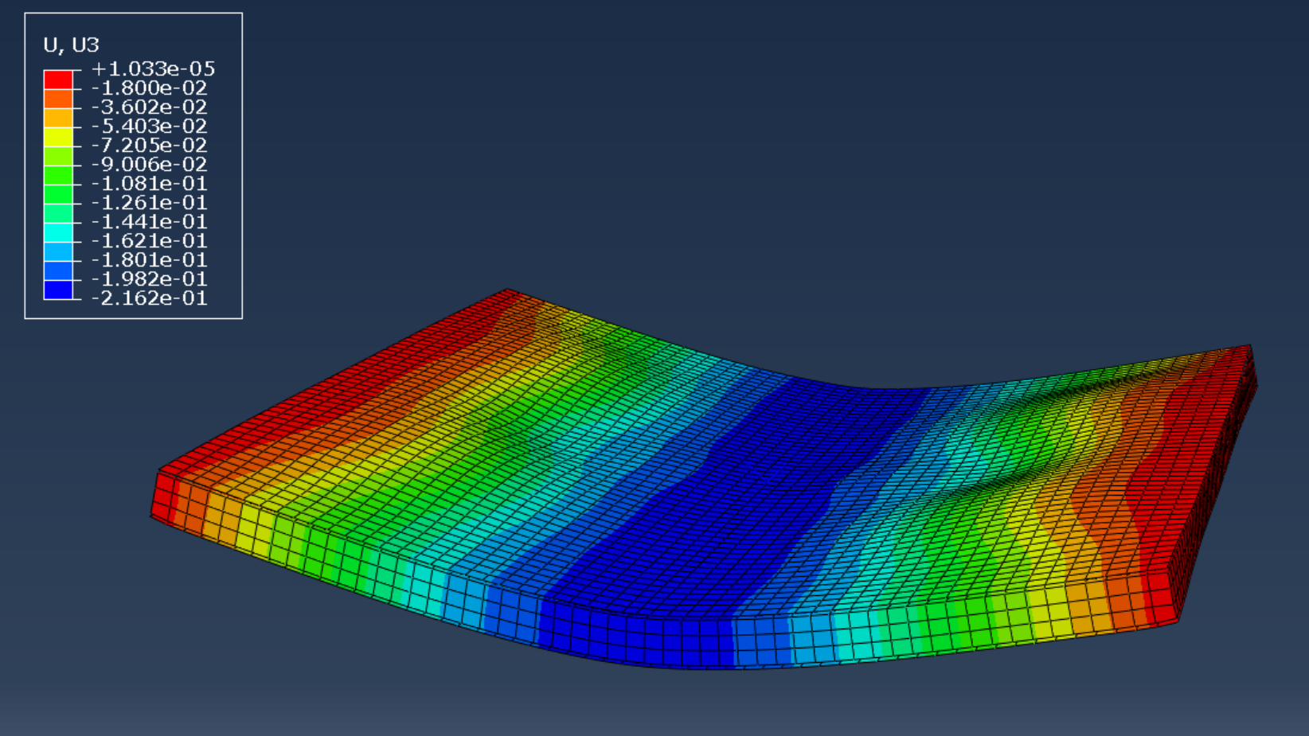
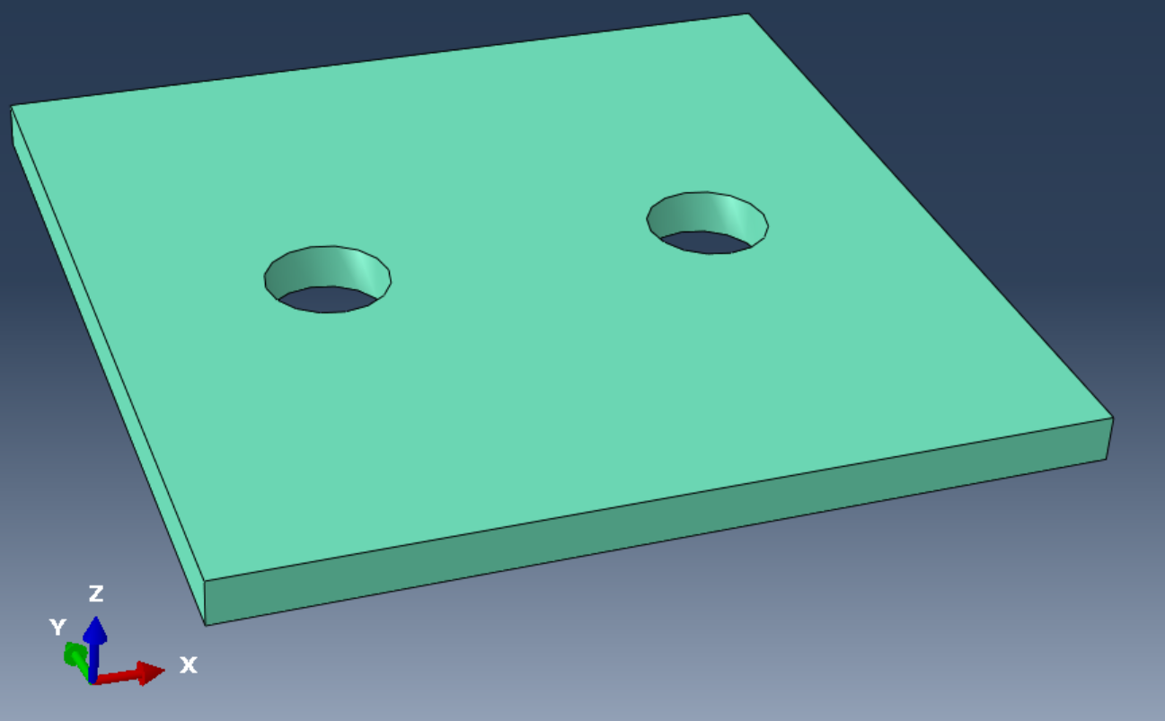
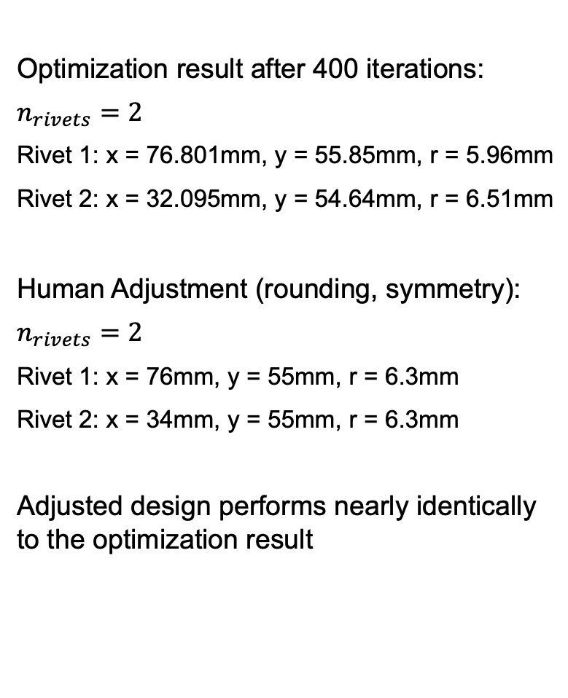
Preliminary Results - Design
Optimization result after 400 iterations:
$$n_{rivets}=2$$
Rivet 1: x = 76.801mm, y = 55.85mm, r = 5.96mm
Rivet 2: x = 32.095mm, y = 54.64mm, r = 6.51mm
Human Adjustment (rounding, symmetry):
$$n_{rivets}=2$$
Rivet 1: x = 76mm, y = 55mm, r = 6.3mm
Rivet 2: x = 34mm, y = 55mm, r = 6.3mm
Adjusted design performs nearly identically to the optimization result

Slide 12
Preliminary Results Conclusion
Optimization procedure works and produces an optimized design in a realistic time frame
Solution converges quickly while also exploring design space
No guarantee of global optimum since the problem is nonconvex
Optimized design makes sense, is manufacturable
Once we decide on a design requirement and cell size, we can create an optimized cell
Easily add other design constraints, objectives
If we decide to take a new approach or have new requirements, the code is easily modified to produce optimal designs with respect to new parameters

Slide 13
Future Work / Recommendations
Two potential paths for this project
Constructing a framework for MESC optimization that can be used in many scenarios
Optimizing specific cell configurations
If we take option 1, the goal will be to expand the code and allow for a wider variety of objectives, constraints, components
If we take option 2, we need to decide on very specific design targets and cell use cases
Current requirements / design constants are arbitrary and used only to show that the method works
Once we decide on a requirement / cell use case, we can produce a specific optimized cell design for production

Slide 14
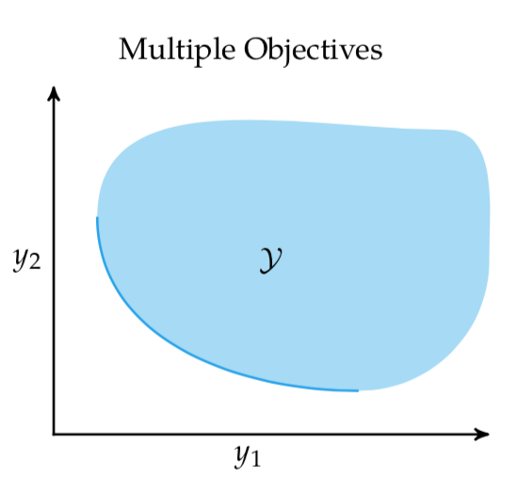
Future Work / Recommendations
Mesh convergence study recommended by David
Anthony said he has attempted this but could not converge
If we go with option 1, part of the work can be constructing Pareto Frontiers
Parametric study between two design parameters
Could be a tradeoff between electrical capacity, stiffness for optimized design
Kochenderfer, M. J., and Wheeler, T. A.,
Algorithms for Optimization, The MIT Press, 2019

